Slide 1
Agile Methodology

Slide 2
Introduction
Agile is a value-driven approach to developing solutions. It is focused on people, adaptability, and providing maximum value to customers.
Although traditional approaches to development, like the waterfall methodology, have worked for organizations in the past, the future is Agile.
The Agile philosophy has become a vital part of many organizations, and there are good reasons for its wide adoption.
When you incorporate Agile ways of working, your team can respond to changing demands quickly and find efficiencies across your projects.

Slide 3
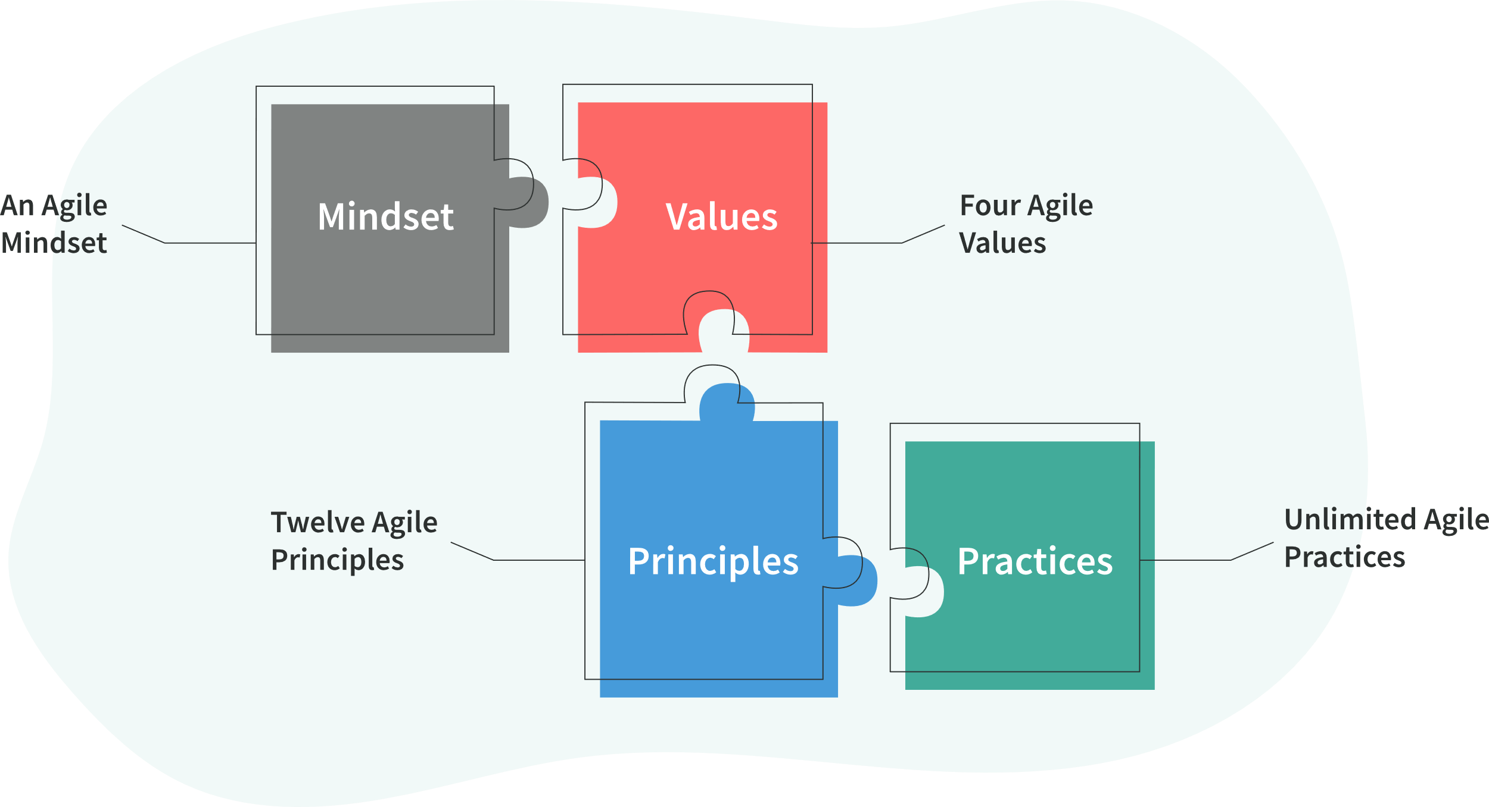
Elements of Agile Development
The Agile philosophy emphasizes quick releases, flexible planning, sustainable development, continuous attention to good design, and ongoing feedback from users.
Agility empowers your team to experiment and adapt to change quickly.

Slide 4
The Agile Mindset
The Agile mindset—a set of attitudes and ways of thinking that support Agile practices—enables independence, creativity, and innovation.
It is the foundation that empowers average teams to transform into high-performing Agile teams.

Slide 5
Agile Principles
Our highest priority is to satisfy the customer through early and continuous delivery of valuable software.
Welcome changing requirements, even late in development. Agile processes harness change for the customer’s competitive advantage.
Build projects around motivated individuals. Give them the environment and support they need, and trust them to get the job done.
Working software is the primary measure of progress.
Agile processes promote sustainable development. The sponsors, developers, and users should be able to maintain a constant pace indefinitely.
The best architectures, requirements, and designs emerge from self-organizing teams.

Slide 6
Agile Ways of Working
As teams start to incorporate Agile—both the mindset and processes—they work in short iterations and focus on the what, how, and why of development work.
Each of these elements empowers teams to engage in rapid iteration and focus on a central goal.
Incorporating Agile into your projects starts by aligning on the “what, why, and how” and then putting those ideas into practice within your process and workflow.
For most teams, this requires pivoting away from the traditional waterfall development model.

Slide 7
Traditional Waterfall Development Model
Until recently, many teams and companies used the traditional waterfall approach to develop solutions. This methodology contrasts with the modern Agile approach.
The waterfall development approach is to work sequentially from start to finish. Clients typically see results at the end of the project life cycle.
If there are errors or defects, the team has to work backward to address and correct them.
The development process is divided into five phases:
Requirements
Design
Develop
Test
Deploy

Slide 8
Scrum Framework
To support the transition, different frameworks have been developed that align with the Agile mindset, values, and principles.
Scrum is one example of a framework that can empower your team to put Agile ways of thinking and working into practice.
It unites business and development.
It focuses on teams delivering products of the highest value while also being productive and efficient.
The business side of the project is typically represented by a Product Owner (PO), who is accountable for maximizing the product's value resulting from the Scrum team’s work. The PO communicates with key stakeholders and is responsible for the product backlog.
The development side is represented by the whole development team, with the Scrum Master facilitating Scrum practices and helping the development team monitor and improve their workflow.

Slide 9
Implementing the Scrum framework means adhering to short, timeboxed iterations called Sprints.
Working in Sprints gives teams multiple opportunities to get fast feedback at different levels.
During each Sprint, teams participate in multiple events. Daily Scrums—brief check-ins that occur each day—enable team members to assess how successfully they are moving toward the Sprint goal.
Other events that occur once per Sprint include:
Sprint Planning: an event when all team members initiate the Sprint by laying out the work to perform
Sprint Review: a timeboxed working session when the team and key stakeholders review the outcomes of a Sprint and identify future steps
Sprint Retrospective: an event when team members discuss what went well, what could be improved, and commit to improvements in the next Sprint
Engaging in these events enables your team to communicate openly about your progress, share and discuss feedback, and remain adaptive to changing needs and requirements.

Slide 10
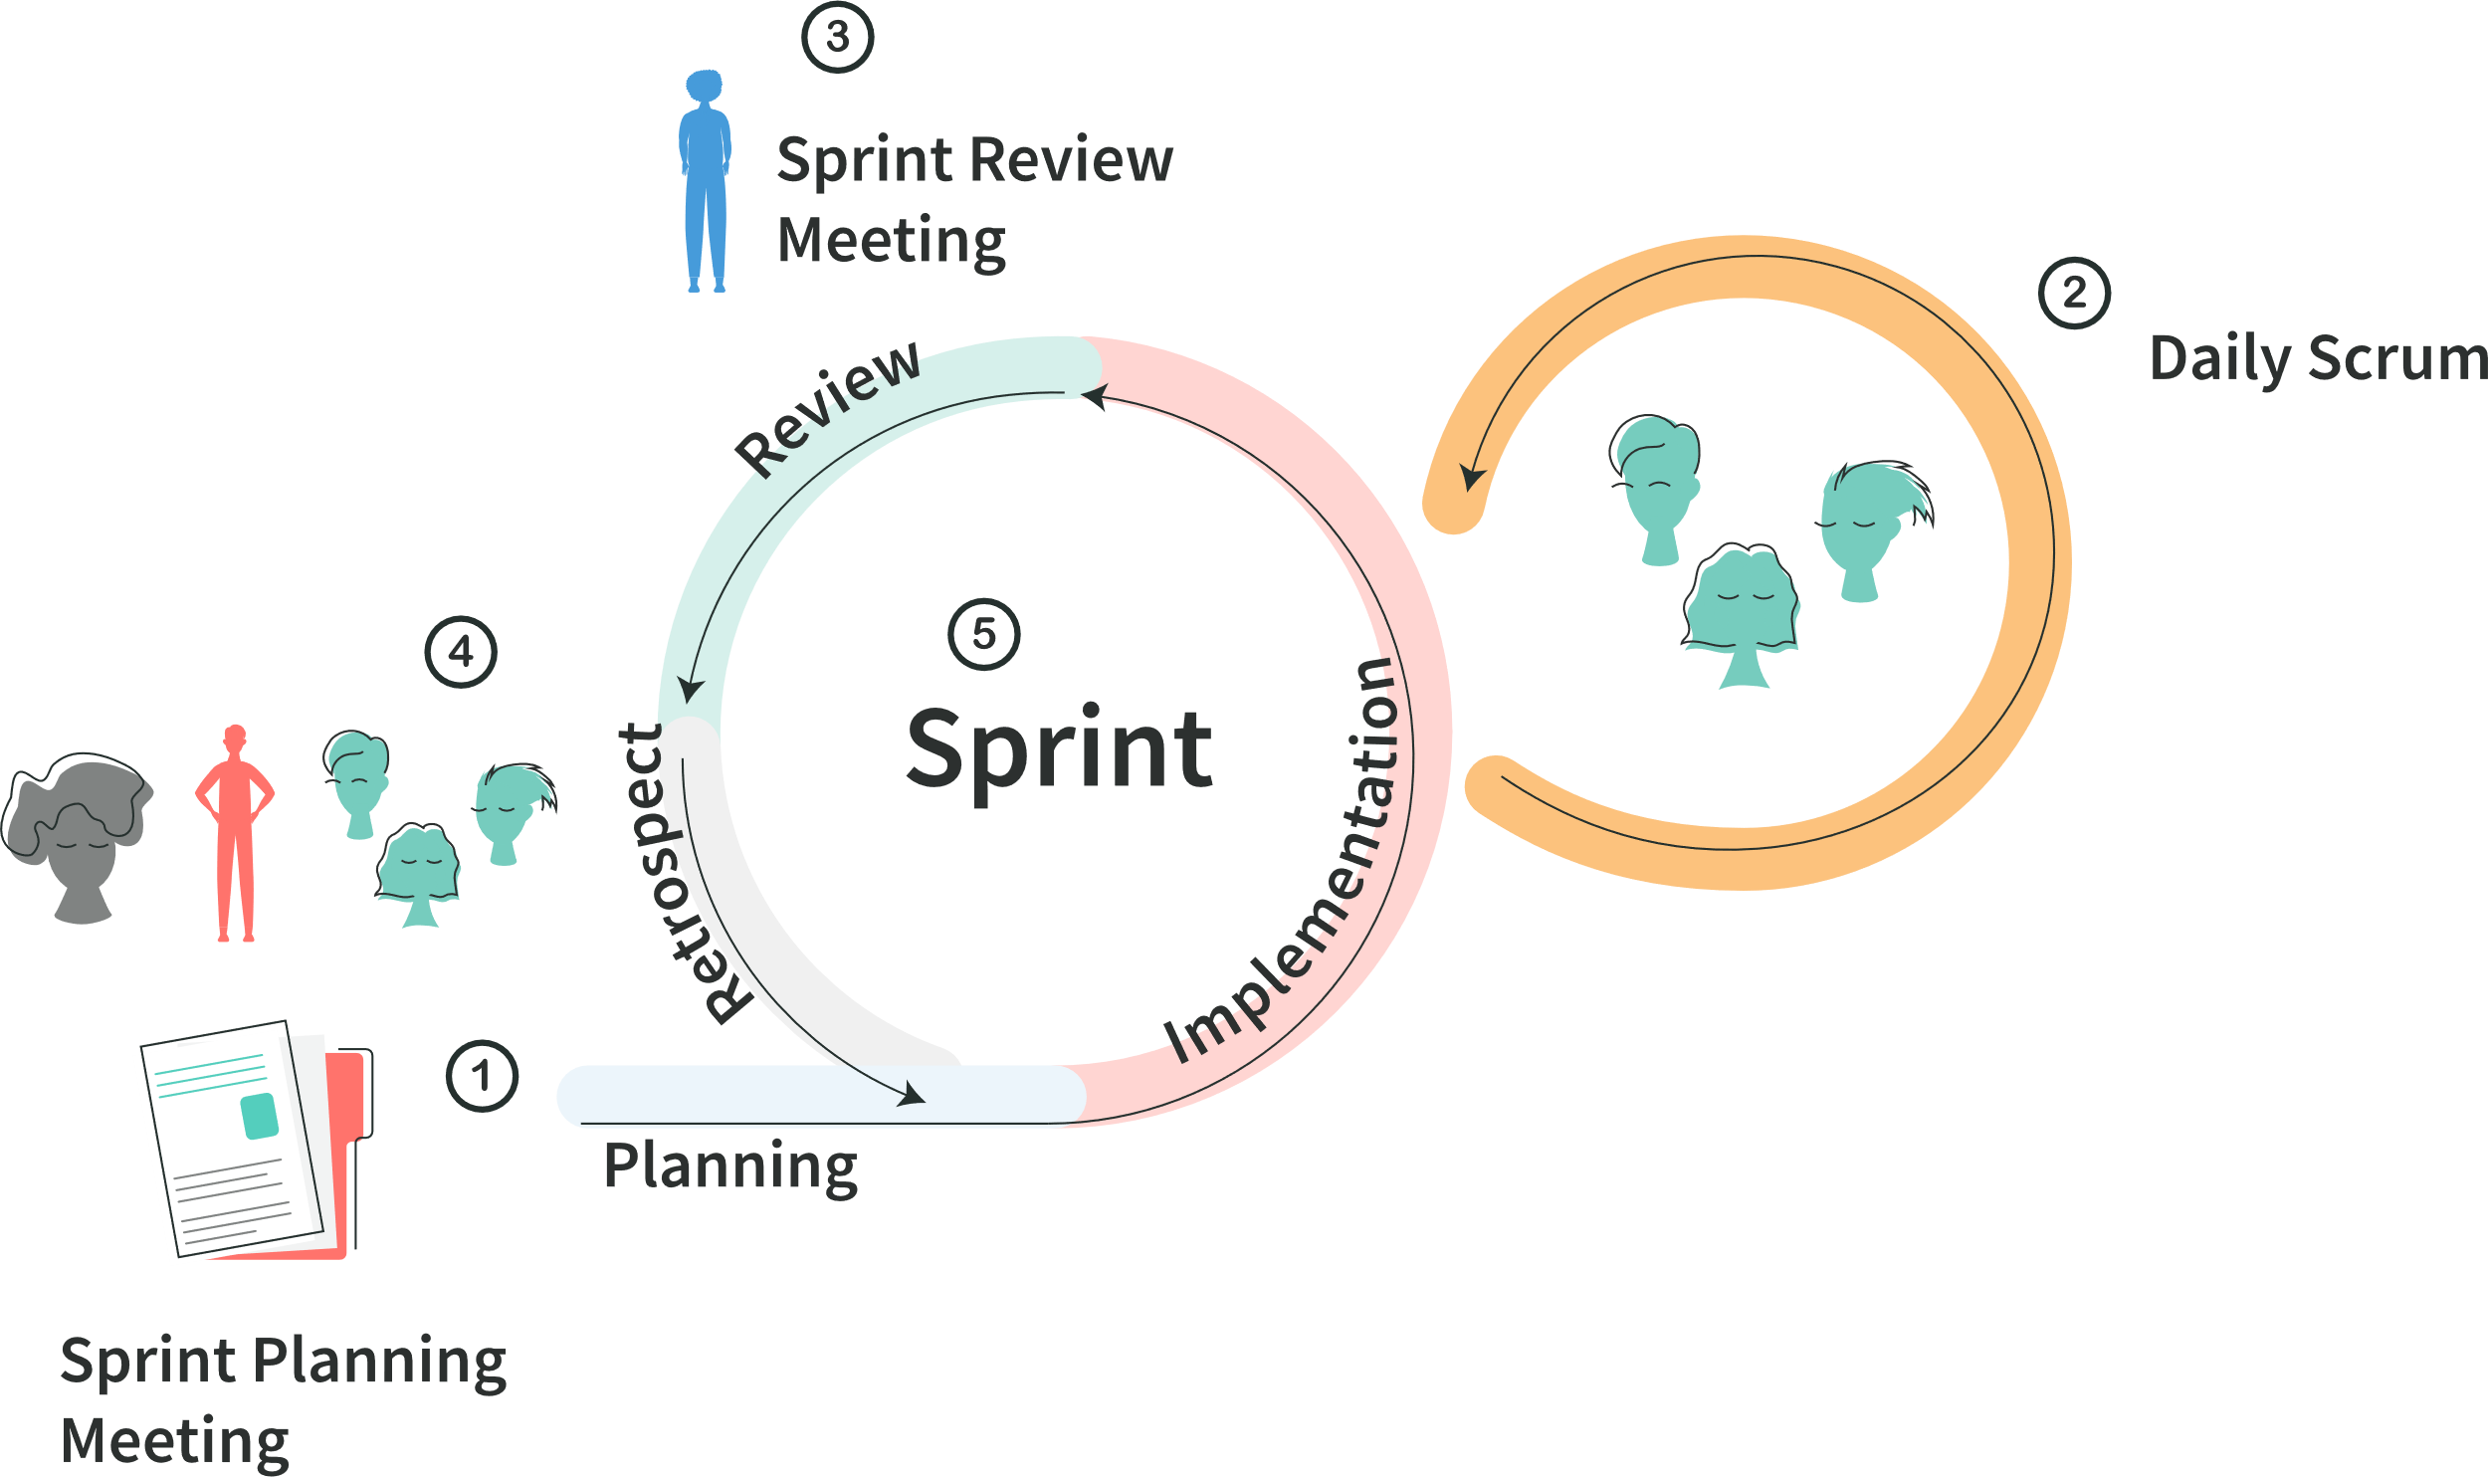

Slide 11
Three Pillars of Scrum
All Scrum events support the three Scrum pillars: transparency, inspection, and adaptation.
Transparency requires all team members to be included in all activities required for a project. Events like Daily Scrums support this pillar. This pillar requires all members of the team to embrace openness and trust, while working toward a common goal.
Inspection ensures that teams prioritize tasks and that the product is of high quality. Events like Sprint Reviews support this pillar. This pillar requires flexibility and collaboration between the team and the customer to ensure the best possible product.
Adaptation is apparent across all Scrum events. It focuses on one of the main aspects of being Agile, which is to always be flexible to accommodate the project and customers’ needs. Any changes identified in the Inspection pillar should be accommodated during Adaptation, with continued flexibility and collaboration between the team and the customer.

